Slide 1
Operating system
Part VIII: Memory (Advanced)
By KONG LingBo (孔令波)

Slide 2
Goals
Know the related concepts
Virtual Memory, Logical address, Physical address, Address translation
Virtual memory
(on-demand) Paging scheme
(on-demand) Segmentation
Segmentation + Paging → Hybrid

Slide 3
Now
It’s time to learn the real techniques used by current OSs to provide VIRTUAL MEMORY
We have known the fact
The instructions and data of a program should be stored in Main Memory first before its execution
With the experience on Windows®, we can infer that a program whose size is larger than the MM can still run
➔ it seems that there is a “virtual” memory!

Slide 4
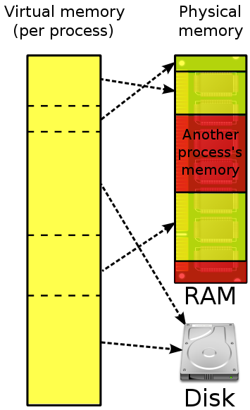
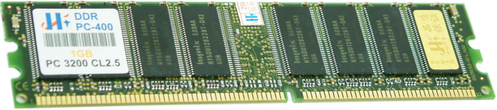
http://searchstorage.techtarget.com/definition/virtual-memory
Virtual memory is a feature of an operating system that
enables a process to use a memory (RAM) address space that is independent of other processes running in the same system,
and use a space that is larger than the actual amount of RAM present, temporarily relegating some contents from RAM to a disk, with little or no overhead.
Virtual memory combines active RAM and inactive memory to form a large range of contiguous addresses.
http://en.wikipedia.org/wiki/Virtual_memory

Slide 5
Virtual Memory
Paging
Basic paging
Paging-based VM
How to support the transparency of using space larger than the physical memory space
Page replacement algorithms
Segmenting
Basic segmenting
Segmentation-based VM
How to support the transparency of using space larger than the physical memory space
Segment-page scheme

Slide 6
Paging (分页)
PPTs from others\SCU_Zhaohui\OS\Chapter07.ppt
The fundament of paging is Fixed Partitioning but with smaller size!
It “partition/cut” the logical space of a process into pages [页]
It “partition/cut” the physical space of MM into frames [帧]
Be default, the sizes of page and frame are same
In 32 bit Windows, 4KB
It seems that the mapping from the process space to MM is easy now
If there is available frame, we can assign a page to that frame
Since a page corresponds to a set of instructions, that process could run when executing those instructions
Yes, that is in fact the basic functions of paging scheme!

Slide 7
Needed data structures
To carry out the paging scheme
Besides the pages of a process, OS should know the mapping relationship between pages of that process and frames of the MM
That is Page table [页表]
Page | Frame

Slide 8
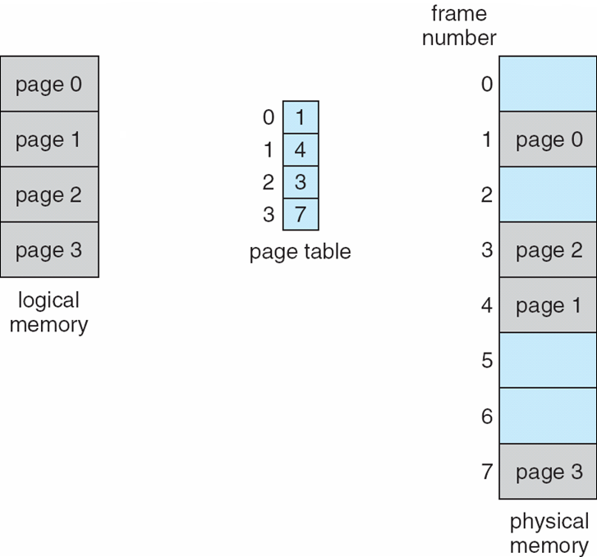
Paging Example
PPTs from others\From Ariel J. Frank\OS381\os7-3_rea.ppt

Slide 9
Virtual Memory: Large as you wish!
Example:
Just 16 bits are needed to address a physical memory of 64KB.
Let’s use a page size of 1KB so that 10 bits are needed for offsets within a page.
For the page number part of a logical address we may use a number of bits larger than 6, say 22 (a modest value!!), “pretending” a 32-bit address.
Now we have 2²² (=4M) pages, each of which is 1KB, so the VM of a process seems 4GB (← 2²²*2¹⁰=2³²=4GB)
This explains why the max size of files in Win32 is 4GB
PPTs from others\From Ariel J. Frank\OS381\os8-1_vir.ppt

Slide 10
A program now is organized into pages logically
Programs are stored as Files in storage media
Program
X=1;
Y= 2;
Z= X+Y;
1
6C
2
6D
6E
Compiler
[编译器]
15
A0
6C
A1
16
A2
6D
A3
50
A4
Machine code
156C→0001010101101100
166D→0001011001101101
5056→0101000001010110
306E→0011000001101110
C000→1100000000000000
56
A5
30
A6
Put executable codes into the
memory of the computer
6E
A7
C0
A8
00
A9
Instructions are mapped into the address space of memory
Executable codes are also stored as Files in storage media

Slide 11
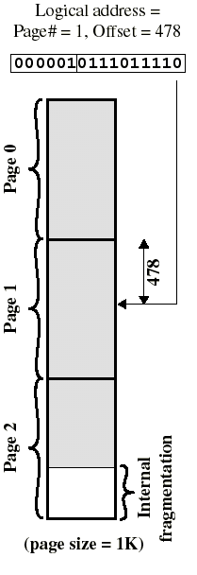
Logical address now
Logical address now is divided into two parts:
Page number (p) – used as an index into a page table which contains the base address of each page in physical memory.
Page offset/displacement (d) – combined with base address to define the physical memory address that is sent to the memory unit.
page number
page offset
p
d
m – n
n
PPTs from others\From Ariel J. Frank\OS381\os7-3_rea.ppt
Notes:
[2015年4月16日22:20:38] 在这里画一下现在的 program 都是按照 Pages 来组织； 另一边， 内存也同样大小分割 – 称之为 frames. 来自 loose-leaf book

Slide 12
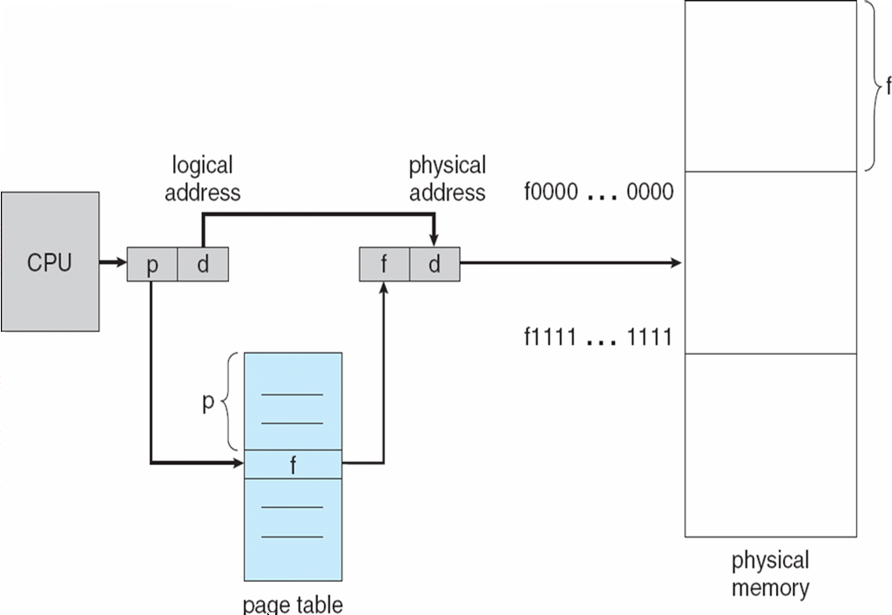
Address Translation now
Address translation at run-time is then easy to implement in hardware:
logical address (p, d) gets translated to physical address (f, d) by indexing the page table with p and appending the same displacement/offset d to the frame number f.
PPTs from others\From Ariel J. Frank\OS381\os7-3_rea.ppt

Slide 13
Sharing
What can be shared
Reentrant code (pure code)
If the code is reentrant, then it never changes during execution. ➔Two or more processes can execute the same code at the same time.
Read-only data
What can not be shared
Each process has its own copy of registers and data storage to hold the data for the process’s execution.
The OS should provides facility to enforce some necessary property for sharing.
PPTs from others\OS PPT in English\ch09.ppt

Slide 14
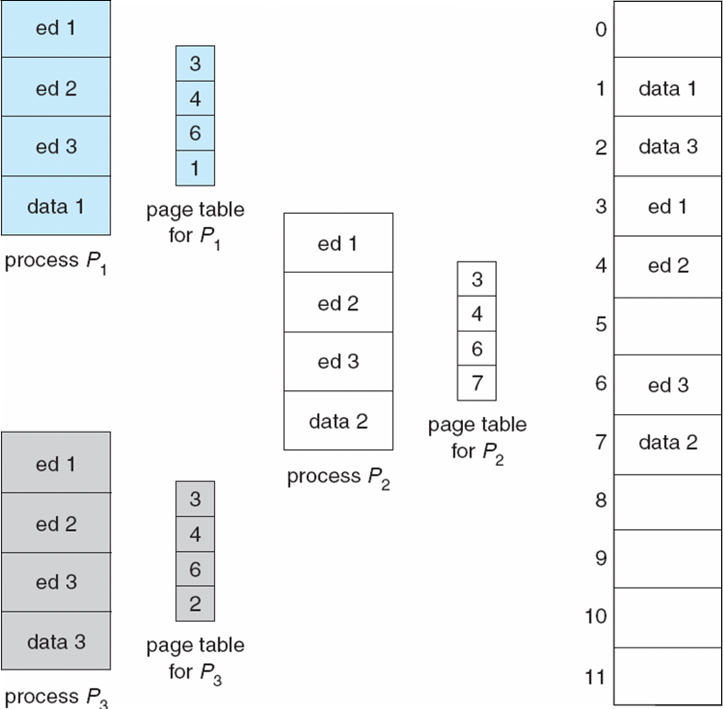
Shared Pages Example
PPTs from others\From Ariel J. Frank\OS381\os7-3_rea.ppt

Slide 15
Paging：The OS Concern
What should the OS do?
Which frames are allocated?
Which frames are available?
How to allocate frames for a newly arrived process?
Placement algorithm (放置算法)
Replacement algorithms (替换算法)
Similar as those discussed in Variable partition part!
PPTs from others\OS PPT in English\ch09.ppt

Slide 16
A computer's main memory is byte addressing, logical addresses and physical addresses are 32-bit, page table entry size is 4 bytes. Please answer the following questions. If use a paging management, and the logical address structure is :
Page Number（20 bits） offset（12 bits）
The size of the page is how many number of bytes?
And calculate the maximum number of bytes occupied by the page table? [2 pts]

Slide 17
In a paging memory management system, there is a page table as following:
If the page size is 4KB, then paging address hardware will convert logical address 0 into physical address（ ）.
A.8192 B.4096 C.2048 D.1024
Page No | 0 | 1 | 2 | 3 | 4
Frame | 2 | 1 | 6 | 3 | 7

Slide 18
Virtual Memory
Paging
Basic paging
Paging-based VM
How to support the transparency of using space larger than the physical memory space
Page replacement algorithms
Segmenting
Basic segmenting
Segmentation-based VM
How to support the transparency of using space larger than the physical memory space
Segment-page scheme

Slide 19
Of course, we need some support for Virtual Memory
Memory management hardware must support paging and/or segmentation [⬅ Discussed in former part].
OS must be able to manage [➔ Concern of this part]
the movement of pages and/or segments between external memory and main memory,
including placement and replacement of pages/segments.
PPTs from others\From Ariel J. Frank\OS381\os8-1_vir.ppt

Slide 20
Now, the execution of a process looks like …
The OS brings into main memory only a few pieces of the program (including its starting point).
An interrupt (memory fault) is generated when the memory reference is on a piece that is not present in main memory – is needed.
OS places the process in a Blocking state.
OS issues a disk I/O Read request to bring into main memory the piece referenced to.
Another process is dispatched to run while the disk I/O takes place.
An interrupt is issued when disk I/O completes; this causes the OS to place the affected process back in the Ready state.
Called Demand Paging!
PPTs from others\From Ariel J. Frank\OS381\os8-1_vir.ppt

Slide 21
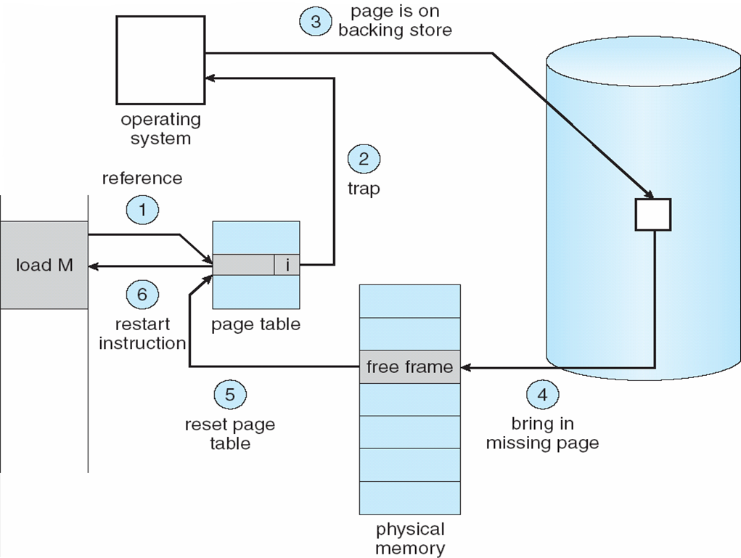
If one page is not in MM yet (Page Fault)
Steps in handling a Page Fault
PPTs from others\From Ariel J. Frank\OS381\os8-1_vir.ppt

Slide 22
Steps in handling a Page Fault
If there is ever a reference to a page not in memory, first reference will cause page fault.
Page fault is handled by the appropriate OS service routines.
Locate needed page on disk (in file or in backing store).
Swap page into free frame (assume available).
Reset page tables – valid-invalid bit = 1.
Restart instruction.
PPTs from others\From Ariel J. Frank\OS381\os8-1_vir.ppt

Slide 23
What happens if there is no free frame?
Page replacement – find some page in memory, but not really in use, swap it out.
Need page replacement algorithm.
Performance – want an algorithm which will result in minimum number of page faults.
Same page may be brought into memory several times.
PPTs from others\From Ariel J. Frank\OS381\os8-1_vir.ppt

Slide 24
Effective Access Time (EAT)
EAT = (1 – p) x memory access + p (page fault overhead + swap page out + swap page in + restart overhead)
“p” means Page Fault Rate
0 ≤ p ≤ 1.0
if p = 0, no page faults
if p = 1, every reference is a fault

Slide 25
Demand Paging Example
Memory access time = 200 nanoseconds [纳秒]
Average page-fault service time = 8 milliseconds [毫秒]
EAT = (1 – p) x 200 + p (8 milliseconds) = (1 – p) x 200 + p x 8,000,000 = 200 + p x 7,999,800
If one access out of 1,000 causes a page fault, then EAT = 200+0.001*7999800 = 8199.8 nanoseconds = 8.2 microseconds [微秒]. 1 millisec = 1,000 microsec = 1,000,000 nanosec
Notes:
[2014-04-04] “This is a slowdown by a factor of 40”, 就是没有缺页时是200纳秒, 而有缺页 – 即便是1000分之一, 也会使得时间降低到 8.2毫秒, 近乎下降了40倍.
也就引出了 “每次有缺页时,将相关的页面也一同预保存至内存中”的思考.
甚至, 将 Page table 放到内存也觉得慢 – 因为访问它的频率过高, 所以, 现在有了 cache,以及 TLB
“A translation lookaside buffer (TLB) is a cache that memory management hardware uses to improve virtual address translation speed.^{[1]} All current desktop, laptop, and server processors include one or more TLBs in the memory management hardware, and it is nearly always present in any hardware that utilizes paged or segmented virtual memory.”
[From http://en.wikipedia.org/wiki/Translation_lookaside_buffer]

Slide 26
How to improve this kind of slowdown?
The solution could be derived from the EAT equation - Improve the access speed, and decrease the page fault
Two strategies
Keeping page table in a higher access speed media
Cache (high speed but quite expensive), and the TLB (translation lookaside buffer)
Prefetching the possible future accessed pages
When page 3 causes a page fault, OS also copies page 2,4,and 5 into MM
Of course, decision is needed – namely the algorithms

Slide 27
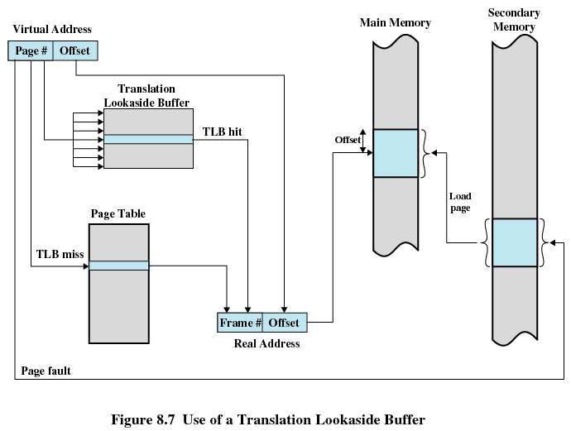
a Translation Look-aside Buffer (TLB)
翻译后备缓冲器
PPTs from others\From Ariel J. Frank\OS381\os8-1_vir.ppt
PPTs from others\OS5e after William Stallings\Chapter08.ppt

Slide 28
Now the EAT with TLB
Parameters
TLB Lookup = 20 nanoseconds
Hit ratio (percentage of times that a particular page is found in the TLB) = 80%
Memory access time = 200 nanoseconds
Average page-fault service time = 8 milliseconds
If one access for Page table out of 1,000 causes a page fault
EAT = (20)*0.8 + [200+(8000000-200)*0.001]*0.2 = 16+ 8199.8*0.2 = 1655.96≈1.6 microseconds

Slide 29
Contemporary Memory Hierarchy & Dynamic Loading
CPU Registers
Primary
(Executable)
L1 Cache Memory
L2 Cache Memory
“Main” Memory
Larger storage
Rotating Magnetic Memory
Faster access
Secondary
Optical Memory
Sequentially Accessed Memory
PPTs from others\cms.dt.uh.edu\chap11.ppt

Slide 30
Virtual Memory
Paging
Basic paging
Paging-based VM
How to support the transparency of using space larger than the physical memory space
Page replacement algorithms
Segmenting
Basic segmenting
Segmentation-based VM
How to support the transparency of using space larger than the physical memory space
Segment-page scheme

Slide 31

Example
A process makes references to 4 pages: A, B, E, and R
Reference stream: BEERBAREBEAR
Physical memory size: 3 pages
PPTs.2012\PPTs from others\www.cs.fsu.edu_~awang_courses_cop4610_f2005\lecture_14_virtual_memory.ppt

Slide 32
The FIFO Policy
Treats page frames allocated to a process as a circular buffer:
When the buffer is full, the oldest page is replaced. Hence first-in, first-out:
A frequently used page is often the oldest, so it will be repeatedly paged out by FIFO.
Simple to implement:
requires only a pointer that circles through the page frames of the process.
PPTs from others\From Ariel J. Frank\OS381\os8-3_vir.ppt

Slide 33
FIFO
Memory page | B | E | E | R | B | A | R | E | B | E | A | R
1 | B
2
3
PPTs.2012\PPTs from others\www.cs.fsu.edu_~awang_courses_cop4610_f2005\lecture_14_virtual_memory.ppt

Slide 34
FIFO
Memory page | B | E | E | R | B | A | R | E | B | E | A | R
1 | B
2 |  | E
3
PPTs.2012\PPTs from others\www.cs.fsu.edu_~awang_courses_cop4610_f2005\lecture_14_virtual_memory.ppt

Slide 35
FIFO
Memory page | B | E | E | R | B | A | R | E | B | E | A | R
1 | B
2 |  | E | *
3
PPTs.2012\PPTs from others\www.cs.fsu.edu_~awang_courses_cop4610_f2005\lecture_14_virtual_memory.ppt

Slide 36
FIFO
Memory page | B | E | E | R | B | A | R | E | B | E | A | R
1 | B
2 |  | E | *
3 |  |  |  | R
PPTs.2012\PPTs from others\www.cs.fsu.edu_~awang_courses_cop4610_f2005\lecture_14_virtual_memory.ppt

Slide 37
FIFO
Memory page | B | E | E | R | B | A | R | E | B | E | A | R
1 | B |  |  |  | *
2 |  | E | *
3 |  |  |  | R
PPTs.2012\PPTs from others\www.cs.fsu.edu_~awang_courses_cop4610_f2005\lecture_14_virtual_memory.ppt

Slide 38
FIFO
Memory page | B | E | E | R | B | A | R | E | B | E | A | R
1 | B |  |  |  | *
2 |  | E | *
3 |  |  |  | R
PPTs.2012\PPTs from others\www.cs.fsu.edu_~awang_courses_cop4610_f2005\lecture_14_virtual_memory.ppt

Slide 39
FIFO
Memory page | B | E | E | R | B | A | R | E | B | E | A | R
1 | B |  |  |  | * | A
2 |  | E | *
3 |  |  |  | R
PPTs.2012\PPTs from others\www.cs.fsu.edu_~awang_courses_cop4610_f2005\lecture_14_virtual_memory.ppt

Slide 40
FIFO
Memory page | B | E | E | R | B | A | R | E | B | E | A | R
1 | B |  |  |  | * | A
2 |  | E | *
3 |  |  |  | R |  |  | *
PPTs.2012\PPTs from others\www.cs.fsu.edu_~awang_courses_cop4610_f2005\lecture_14_virtual_memory.ppt

Slide 41
FIFO
Memory page | B | E | E | R | B | A | R | E | B | E | A | R
1 | B |  |  |  | * | A
2 |  | E | * |  |  |  |  | *
3 |  |  |  | R |  |  | *
PPTs.2012\PPTs from others\www.cs.fsu.edu_~awang_courses_cop4610_f2005\lecture_14_virtual_memory.ppt

Slide 42
FIFO
Memory page | B | E | E | R | B | A | R | E | B | E | A | R
1 | B |  |  |  | * | A
2 |  | E | * |  |  |  |  | *
3 |  |  |  | R |  |  | *
PPTs.2012\PPTs from others\www.cs.fsu.edu_~awang_courses_cop4610_f2005\lecture_14_virtual_memory.ppt

Slide 43
FIFO
Memory page | B | E | E | R | B | A | R | E | B | E | A | R
1 | B |  |  |  | * | A
2 |  | E | * |  |  |  |  | * | B
3 |  |  |  | R |  |  | *
PPTs.2012\PPTs from others\www.cs.fsu.edu_~awang_courses_cop4610_f2005\lecture_14_virtual_memory.ppt

Slide 44
FIFO
Memory page | B | E | E | R | B | A | R | E | B | E | A | R
1 | B |  |  |  | * | A
2 |  | E | * |  |  |  |  | * | B
3 |  |  |  | R |  |  | *
PPTs.2012\PPTs from others\www.cs.fsu.edu_~awang_courses_cop4610_f2005\lecture_14_virtual_memory.ppt

Slide 45
FIFO
Memory page | B | E | E | R | B | A | R | E | B | E | A | R
1 | B |  |  |  | * | A
2 |  | E | * |  |  |  |  | * | B
3 |  |  |  | R |  |  | * |  |  | E
PPTs.2012\PPTs from others\www.cs.fsu.edu_~awang_courses_cop4610_f2005\lecture_14_virtual_memory.ppt

Slide 46
FIFO
Memory page | B | E | E | R | B | A | R | E | B | E | A | R
1 | B |  |  |  | * | A |  |  |  |  | *
2 |  | E | * |  |  |  |  | * | B
3 |  |  |  | R |  |  | * |  |  | E
PPTs.2012\PPTs from others\www.cs.fsu.edu_~awang_courses_cop4610_f2005\lecture_14_virtual_memory.ppt

Slide 47
FIFO
Memory page | B | E | E | R | B | A | R | E | B | E | A | R
1 | B |  |  |  | * | A |  |  |  |  | *
2 |  | E | * |  |  |  |  | * | B
3 |  |  |  | R |  |  | * |  |  | E
PPTs.2012\PPTs from others\www.cs.fsu.edu_~awang_courses_cop4610_f2005\lecture_14_virtual_memory.ppt

Slide 48
FIFO
Memory page | B | E | E | R | B | A | R | E | B | E | A | R
1 | B |  |  |  | * | A |  |  |  |  | * | R
2 |  | E | * |  |  |  |  | * | B
3 |  |  |  | R |  |  | * |  |  | E
PPTs.2012\PPTs from others\www.cs.fsu.edu_~awang_courses_cop4610_f2005\lecture_14_virtual_memory.ppt

Slide 49
FIFO
7 page faults
Memory page | B | E | E | R | B | A | R | E | B | E | A | R
1 | B |  |  |  | * | A |  |  |  |  | * | R
2 |  | E | * |  |  |  |  | * | B
3 |  |  |  | R |  |  | * |  |  | E
PPTs.2012\PPTs from others\www.cs.fsu.edu_~awang_courses_cop4610_f2005\lecture_14_virtual_memory.ppt

Slide 50
FIFO
compulsory
D.J.[kəmˈpʌlsəri]
adj.必须做的, 强制性的
4 compulsory cache misses
Memory page | B | E | E | R | B | A | R | E | B | E | A | R
1 | B |  |  |  | * | A |  |  |  |  | * | R
2 |  | E | * |  |  |  |  | * | B
3 |  |  |  | R |  |  | * |  |  | E
PPTs.2012\PPTs from others\www.cs.fsu.edu_~awang_courses_cop4610_f2005\lecture_14_virtual_memory.ppt

Slide 51
Optimal Page Replacement
The Optimal policy selects for replacement the page that will not be used for longest period of time.
Impossible to implement (need to know the future) but serves as a standard to compare with the other algorithms we shall study.
PPTs from others\From Ariel J. Frank\OS381\os8-3_vir.ppt

Slide 52
Optimal (MIN)
Memory page | B | E | E | R | B | A | R | E | B | E | A | R
1 | B
2 |  | E | *
3 |  |  |  | R
PPTs.2012\PPTs from others\www.cs.fsu.edu_~awang_courses_cop4610_f2005\lecture_14_virtual_memory.ppt

Slide 53
Optimal (MIN)
Memory page | B | E | E | R | B | A | R | E | B | E | A | R
1 | B |  |  |  | *
2 |  | E | *
3 |  |  |  | R
PPTs.2012\PPTs from others\www.cs.fsu.edu_~awang_courses_cop4610_f2005\lecture_14_virtual_memory.ppt

Slide 54
Optimal (MIN)
Memory page | B | E | E | R | B | A | R | E | B | E | A | R
1 | B |  |  |  | *
2 |  | E | *
3 |  |  |  | R
PPTs.2012\PPTs from others\www.cs.fsu.edu_~awang_courses_cop4610_f2005\lecture_14_virtual_memory.ppt

Slide 55
MIN
Memory page | B | E | E | R | B | A | R | E | B | E | A | R
1 | B |  |  |  | * | A
2 |  | E | *
3 |  |  |  | R
PPTs.2012\PPTs from others\www.cs.fsu.edu_~awang_courses_cop4610_f2005\lecture_14_virtual_memory.ppt

Slide 56
MIN
Memory page | B | E | E | R | B | A | R | E | B | E | A | R
1 | B |  |  |  | * | A
2 |  | E | *
3 |  |  |  | R |  |  | *
PPTs.2012\PPTs from others\www.cs.fsu.edu_~awang_courses_cop4610_f2005\lecture_14_virtual_memory.ppt

Slide 57
MIN
Memory page | B | E | E | R | B | A | R | E | B | E | A | R
1 | B |  |  |  | * | A
2 |  | E | * |  |  |  |  | *
3 |  |  |  | R |  |  | *
PPTs.2012\PPTs from others\www.cs.fsu.edu_~awang_courses_cop4610_f2005\lecture_14_virtual_memory.ppt

Slide 58
MIN
Memory page | B | E | E | R | B | A | R | E | B | E | A | R
1 | B |  |  |  | * | A
2 |  | E | * |  |  |  |  | *
3 |  |  |  | R |  |  | *
PPTs.2012\PPTs from others\www.cs.fsu.edu_~awang_courses_cop4610_f2005\lecture_14_virtual_memory.ppt

Slide 59
MIN
Memory page | B | E | E | R | B | A | R | E | B | E | A | R
1 | B |  |  |  | * | A
2 |  | E | * |  |  |  |  | *
3 |  |  |  | R |  |  | * |  | B
PPTs.2012\PPTs from others\www.cs.fsu.edu_~awang_courses_cop4610_f2005\lecture_14_virtual_memory.ppt

Slide 60
MIN
Memory page | B | E | E | R | B | A | R | E | B | E | A | R
1 | B |  |  |  | * | A
2 |  | E | * |  |  |  |  | * |  | *
3 |  |  |  | R |  |  | * |  | B
PPTs.2012\PPTs from others\www.cs.fsu.edu_~awang_courses_cop4610_f2005\lecture_14_virtual_memory.ppt

Slide 61
MIN
Memory page | B | E | E | R | B | A | R | E | B | E | A | R
1 | B |  |  |  | * | A |  |  |  |  | *
2 |  | E | * |  |  |  |  | * |  | *
3 |  |  |  | R |  |  | * |  | B
PPTs.2012\PPTs from others\www.cs.fsu.edu_~awang_courses_cop4610_f2005\lecture_14_virtual_memory.ppt

Slide 62
MIN
Memory page | B | E | E | R | B | A | R | E | B | E | A | R
1 | B |  |  |  | * | A |  |  |  |  | * | R
2 |  | E | * |  |  |  |  | * |  | *
3 |  |  |  | R |  |  | * |  | B
PPTs.2012\PPTs from others\www.cs.fsu.edu_~awang_courses_cop4610_f2005\lecture_14_virtual_memory.ppt

Slide 63
MIN
6 page faults
Memory page | B | E | E | R | B | A | R | E | B | E | A | R
1 | B |  |  |  | * | A |  |  |  |  | * | R
2 |  | E | * |  |  |  |  | * |  | *
3 |  |  |  | R |  |  | * |  | B
PPTs.2012\PPTs from others\www.cs.fsu.edu_~awang_courses_cop4610_f2005\lecture_14_virtual_memory.ppt

Slide 64
The LRU Policy [least recently used:最近最少使用算法]
Replaces the page that has not been referenced for the longest time recently:
By the principle of locality, this should be the page least likely to be referenced in the near future.
performs nearly as well as the optimal policy.

Slide 65
LRU
Memory page | B | E | E | R | B | A | R | E | B | E | A | R
1 | B
2 |  | E | *
3 |  |  |  | R
PPTs.2012\PPTs from others\www.cs.fsu.edu_~awang_courses_cop4610_f2005\lecture_14_virtual_memory.ppt

Slide 66
LRU
Memory page | B | E | E | R | B | A | R | E | B | E | A | R
1 | B |  |  |  | *
2 |  | E | *
3 |  |  |  | R
PPTs.2012\PPTs from others\www.cs.fsu.edu_~awang_courses_cop4610_f2005\lecture_14_virtual_memory.ppt

Slide 67
LRU
Memory page | B | E | E | R | B | A | R | E | B | E | A | R
1 | B |  |  |  | *
2 |  | E | *
3 |  |  |  | R
PPTs.2012\PPTs from others\www.cs.fsu.edu_~awang_courses_cop4610_f2005\lecture_14_virtual_memory.ppt

Slide 68
LRU
Memory page | B | E | E | R | B | A | R | E | B | E | A | R
1 | B |  |  |  | *
2 |  | E | * |  |  | A
3 |  |  |  | R
PPTs.2012\PPTs from others\www.cs.fsu.edu_~awang_courses_cop4610_f2005\lecture_14_virtual_memory.ppt

Slide 69
LRU
Memory page | B | E | E | R | B | A | R | E | B | E | A | R
1 | B |  |  |  | *
2 |  | E | * |  |  | A
3 |  |  |  | R |  |  | *
PPTs.2012\PPTs from others\www.cs.fsu.edu_~awang_courses_cop4610_f2005\lecture_14_virtual_memory.ppt

Slide 70
LRU
Memory page | B | E | E | R | B | A | R | E | B | E | A | R
1 | B |  |  |  | *
2 |  | E | * |  |  | A
3 |  |  |  | R |  |  | *
PPTs.2012\PPTs from others\www.cs.fsu.edu_~awang_courses_cop4610_f2005\lecture_14_virtual_memory.ppt

Slide 71
LRU
Memory page | B | E | E | R | B | A | R | E | B | E | A | R
1 | B |  |  |  | * |  |  | E
2 |  | E | * |  |  | A
3 |  |  |  | R |  |  | *
PPTs.2012\PPTs from others\www.cs.fsu.edu_~awang_courses_cop4610_f2005\lecture_14_virtual_memory.ppt

Slide 72
LRU
Memory page | B | E | E | R | B | A | R | E | B | E | A | R
1 | B |  |  |  | * |  |  | E
2 |  | E | * |  |  | A
3 |  |  |  | R |  |  | *
PPTs.2012\PPTs from others\www.cs.fsu.edu_~awang_courses_cop4610_f2005\lecture_14_virtual_memory.ppt

Slide 73
LRU
Memory page | B | E | E | R | B | A | R | E | B | E | A | R
1 | B |  |  |  | * |  |  | E
2 |  | E | * |  |  | A |  |  | B
3 |  |  |  | R |  |  | *
PPTs.2012\PPTs from others\www.cs.fsu.edu_~awang_courses_cop4610_f2005\lecture_14_virtual_memory.ppt

Slide 74
LRU
Memory page | B | E | E | R | B | A | R | E | B | E | A | R
1 | B |  |  |  | * |  |  | E |  | *
2 |  | E | * |  |  | A |  |  | B
3 |  |  |  | R |  |  | *
PPTs.2012\PPTs from others\www.cs.fsu.edu_~awang_courses_cop4610_f2005\lecture_14_virtual_memory.ppt

Slide 75
LRU
Memory page | B | E | E | R | B | A | R | E | B | E | A | R
1 | B |  |  |  | * |  |  | E |  | *
2 |  | E | * |  |  | A |  |  | B
3 |  |  |  | R |  |  | *
PPTs.2012\PPTs from others\www.cs.fsu.edu_~awang_courses_cop4610_f2005\lecture_14_virtual_memory.ppt

Slide 76
LRU
Memory page | B | E | E | R | B | A | R | E | B | E | A | R
1 | B |  |  |  | * |  |  | E |  | *
2 |  | E | * |  |  | A |  |  | B
3 |  |  |  | R |  |  | * |  |  |  | A
PPTs.2012\PPTs from others\www.cs.fsu.edu_~awang_courses_cop4610_f2005\lecture_14_virtual_memory.ppt

Slide 77
LRU
Memory page | B | E | E | R | B | A | R | E | B | E | A | R
1 | B |  |  |  | * |  |  | E |  | *
2 |  | E | * |  |  | A |  |  | B
3 |  |  |  | R |  |  | * |  |  |  | A
PPTs.2012\PPTs from others\www.cs.fsu.edu_~awang_courses_cop4610_f2005\lecture_14_virtual_memory.ppt

Slide 78
LRU
Memory page | B | E | E | R | B | A | R | E | B | E | A | R
1 | B |  |  |  | * |  |  | E |  | *
2 |  | E | * |  |  | A |  |  | B |  |  | R
3 |  |  |  | R |  |  | * |  |  |  | A
PPTs.2012\PPTs from others\www.cs.fsu.edu_~awang_courses_cop4610_f2005\lecture_14_virtual_memory.ppt

Slide 79
LRU
8 page faults
Memory page | B | E | E | R | B | A | R | E | B | E | A | R
1 | B |  |  |  | * |  |  | E |  | *
2 |  | E | * |  |  | A |  |  | B |  |  | R
3 |  |  |  | R |  |  | * |  |  |  | A
PPTs.2012\PPTs from others\www.cs.fsu.edu_~awang_courses_cop4610_f2005\lecture_14_virtual_memory.ppt

Slide 80
The Clock (Second Chance) Policy
Replaces an old page, but not the oldest page
Arranges physical pages in a circle
With a clock hand
Each page has a used bit
Set to 1 on reference
On page fault, sweep the clock hand
If the used bit == 1, set it to 0 and advance the hand
If the used bit == 0, pick the page for replacement
PPTs from others\From Ariel J. Frank\OS381\os8-3_vir.ppt

Slide 81
The Clock (Second Chance) Policy
The set of frames candidate for replacement is considered as a circular buffer.
When a page is replaced, a pointer is set to point to the next frame in buffer.
A reference bit for each frame is set to 1 whenever:
a page is first loaded into the frame.
the corresponding page is referenced.
When it is time to replace a page, the first frame encountered with the reference bit set to 0 is replaced:
During the search for replacement, each reference bit set to 1 is changed to 0.
PPTs from others\From Ariel J. Frank\OS381\os8-3_vir.ppt

Slide 82
CLOCK
Memory page | B | E | E | R | B | A | R | E | B | E | A | R
1 | B*
2
3
PPTs.2012\PPTs from others\www.cs.fsu.edu_~awang_courses_cop4610_f2005\lecture_14_virtual_memory.ppt

Slide 83
CLOCK
Memory page | B | E | E | R | B | A | R | E | B | E | A | R
1 | B*
2 |  | E*
3
PPTs.2012\PPTs from others\www.cs.fsu.edu_~awang_courses_cop4610_f2005\lecture_14_virtual_memory.ppt

Slide 84
CLOCK
Memory page | B | E | E | R | B | A | R | E | B | E | A | R
1 | B*
2 |  | E* | E*
3
PPTs.2012\PPTs from others\www.cs.fsu.edu_~awang_courses_cop4610_f2005\lecture_14_virtual_memory.ppt

Slide 85
CLOCK
Memory page | B | E | E | R | B | A | R | E | B | E | A | R
1 | B*
2 |  | E* | E*
3 |  |  |  | R*
PPTs.2012\PPTs from others\www.cs.fsu.edu_~awang_courses_cop4610_f2005\lecture_14_virtual_memory.ppt

Slide 86
CLOCK
Memory page | B | E | E | R | B | A | R | E | B | E | A | R
1 | B* |  |  |  | B*
2 |  | E* | E*
3 |  |  |  | R*
PPTs.2012\PPTs from others\www.cs.fsu.edu_~awang_courses_cop4610_f2005\lecture_14_virtual_memory.ppt

Slide 87
CLOCK
Here we need a replacement
Since there is a “*”, clear “*” and advance the hand
Memory page | B | E | E | R | B | A | R | E | B | E | A | R
1 | B* |  |  |  | B*
2 |  | E* | E*
3 |  |  |  | R*
PPTs.2012\PPTs from others\www.cs.fsu.edu_~awang_courses_cop4610_f2005\lecture_14_virtual_memory.ppt

Slide 88
CLOCK
Since there is a “*”, clear “*” and advance the hand
Memory page | B | E | E | R | B | A | R | E | B | E | A | R
1 | B* |  |  |  | B* | B
2 |  | E* | E* |  |  | E
3 |  |  |  | R*
PPTs.2012\PPTs from others\www.cs.fsu.edu_~awang_courses_cop4610_f2005\lecture_14_virtual_memory.ppt

Slide 89
CLOCK
Since there is a “*”, clear “*” and advance the hand
Memory page | B | E | E | R | B | A | R | E | B | E | A | R
1 | B* |  |  |  | B* | B
2 |  | E* | E* |  |  | E
3 |  |  |  | R* |  | R
PPTs.2012\PPTs from others\www.cs.fsu.edu_~awang_courses_cop4610_f2005\lecture_14_virtual_memory.ppt

Slide 90
CLOCK
Now, we can assign A to this position
Memory page | B | E | E | R | B | A | R | E | B | E | A | R
1 | B* |  |  |  | B* | A*
2 |  | E* | E* |  |  | E
3 |  |  |  | R* |  | R
PPTs.2012\PPTs from others\www.cs.fsu.edu_~awang_courses_cop4610_f2005\lecture_14_virtual_memory.ppt

Slide 91
CLOCK
Memory page | B | E | E | R | B | A | R | E | B | E | A | R
1 | B* |  |  |  | B* | A*
2 |  | E* | E* |  |  | E
3 |  |  |  | R* |  | R | R*
PPTs.2012\PPTs from others\www.cs.fsu.edu_~awang_courses_cop4610_f2005\lecture_14_virtual_memory.ppt

Slide 92
CLOCK
Memory page | B | E | E | R | B | A | R | E | B | E | A | R
1 | B* |  |  |  | B* | A*
2 |  | E* | E* |  |  | E |  | E*
3 |  |  |  | R* |  | R | R*
PPTs.2012\PPTs from others\www.cs.fsu.edu_~awang_courses_cop4610_f2005\lecture_14_virtual_memory.ppt

Slide 93
CLOCK
A page fault again, clear “*” and advance the hand
Memory page | B | E | E | R | B | A | R | E | B | E | A | R
1 | B* |  |  |  | B* | A*
2 |  | E* | E* |  |  | E |  | E* | E
3 |  |  |  | R* |  | R | R*
PPTs.2012\PPTs from others\www.cs.fsu.edu_~awang_courses_cop4610_f2005\lecture_14_virtual_memory.ppt

Slide 94
CLOCK
Clear “*” and advance the hand
Memory page | B | E | E | R | B | A | R | E | B | E | A | R
1 | B* |  |  |  | B* | A*
2 |  | E* | E* |  |  | E |  | E* | E
3 |  |  |  | R* |  | R | R* |  | R
PPTs.2012\PPTs from others\www.cs.fsu.edu_~awang_courses_cop4610_f2005\lecture_14_virtual_memory.ppt

Slide 95
CLOCK
Clear “*” and advance the hand
Memory page | B | E | E | R | B | A | R | E | B | E | A | R
1 | B* |  |  |  | B* | A* |  |  | A
2 |  | E* | E* |  |  | E |  | E* | E
3 |  |  |  | R* |  | R | R* |  | R
PPTs.2012\PPTs from others\www.cs.fsu.edu_~awang_courses_cop4610_f2005\lecture_14_virtual_memory.ppt

Slide 96
CLOCK
Now put B here, because there is no “*” here
Memory page | B | E | E | R | B | A | R | E | B | E | A | R
1 | B* |  |  |  | B* | A* |  |  | A
2 |  | E* | E* |  |  | E |  | E* | B*
3 |  |  |  | R* |  | R | R* |  | R
PPTs.2012\PPTs from others\www.cs.fsu.edu_~awang_courses_cop4610_f2005\lecture_14_virtual_memory.ppt

Slide 97
CLOCK
Memory page | B | E | E | R | B | A | R | E | B | E | A | R
1 | B* |  |  |  | B* | A* |  |  | A
2 |  | E* | E* |  |  | E |  | E* | B*
3 |  |  |  | R* |  | R | R* |  | R | E*
PPTs.2012\PPTs from others\www.cs.fsu.edu_~awang_courses_cop4610_f2005\lecture_14_virtual_memory.ppt

Slide 98
CLOCK
Memory page | B | E | E | R | B | A | R | E | B | E | A | R
1 | B* |  |  |  | B* | A* |  |  | A |  | A*
2 |  | E* | E* |  |  | E |  | E* | B*
3 |  |  |  | R* |  | R | R* |  | R | E*
PPTs.2012\PPTs from others\www.cs.fsu.edu_~awang_courses_cop4610_f2005\lecture_14_virtual_memory.ppt

Slide 99
CLOCK
A page fault again, clear “*” and advance the hand
Memory page | B | E | E | R | B | A | R | E | B | E | A | R
1 | B* |  |  |  | B* | A* |  |  | A |  | A* | A
2 |  | E* | E* |  |  | E |  | E* | B*
3 |  |  |  | R* |  | R | R* |  | R | E*
PPTs.2012\PPTs from others\www.cs.fsu.edu_~awang_courses_cop4610_f2005\lecture_14_virtual_memory.ppt

Slide 100
CLOCK
Clear “*” and advance the hand
Memory page | B | E | E | R | B | A | R | E | B | E | A | R
1 | B* |  |  |  | B* | A* |  |  | A |  | A* | A
2 |  | E* | E* |  |  | E |  | E* | B* |  |  | B
3 |  |  |  | R* |  | R | R* |  | R | E*
PPTs.2012\PPTs from others\www.cs.fsu.edu_~awang_courses_cop4610_f2005\lecture_14_virtual_memory.ppt

Slide 101
CLOCK
Clear “*” and advance the hand
Memory page | B | E | E | R | B | A | R | E | B | E | A | R
1 | B* |  |  |  | B* | A* |  |  | A |  | A* | A
2 |  | E* | E* |  |  | E |  | E* | B* |  |  | B
3 |  |  |  | R* |  | R | R* |  | R | E* |  | E
PPTs.2012\PPTs from others\www.cs.fsu.edu_~awang_courses_cop4610_f2005\lecture_14_virtual_memory.ppt

Slide 102
CLOCK
Now put R here !
Memory page | B | E | E | R | B | A | R | E | B | E | A | R
1 | B* |  |  |  | B* | A* |  |  | A |  | A* | R*
2 |  | E* | E* |  |  | E |  | E* | B* |  |  | B
3 |  |  |  | R* |  | R | R* |  | R | E* |  | E
PPTs.2012\PPTs from others\www.cs.fsu.edu_~awang_courses_cop4610_f2005\lecture_14_virtual_memory.ppt

Slide 103


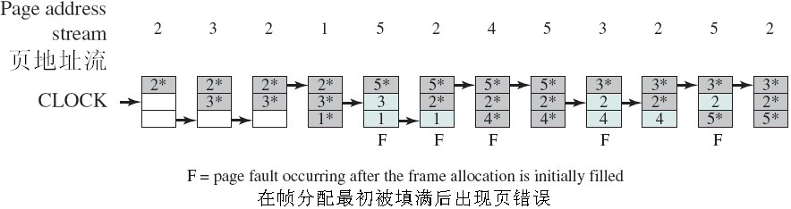
Clock与LRU、FIFO比较
*号表示R=1，箭头表示指针
Clock通过设置R位保护了常用的页面
Notes:
[2016年10月30日18:08:27] 没错

Slide 104
工作集（Working Set）
1968年由P.Denning提出
引入工作集的目的是依据进程在过去的一段时间内访问的页面来调整驻留集大小
工作集是一个进程执行过程中某段时间内所访问的页面的集合，可用一个二元函数W(t, Δ)表示：
t 是执行时刻
Δ是一个虚拟时间段，称为窗口大小(window size)，它采用“虚拟时间”单位(即实际执行时间，阻塞时不计时)，可用执行的指令数目或处理器执行时间来计算
工作集是在 [t-Δ, t] 虚拟时间段内所访问的页面的集合，| W(t, Δ) | 指工作集大小，即页面数目

Slide 105
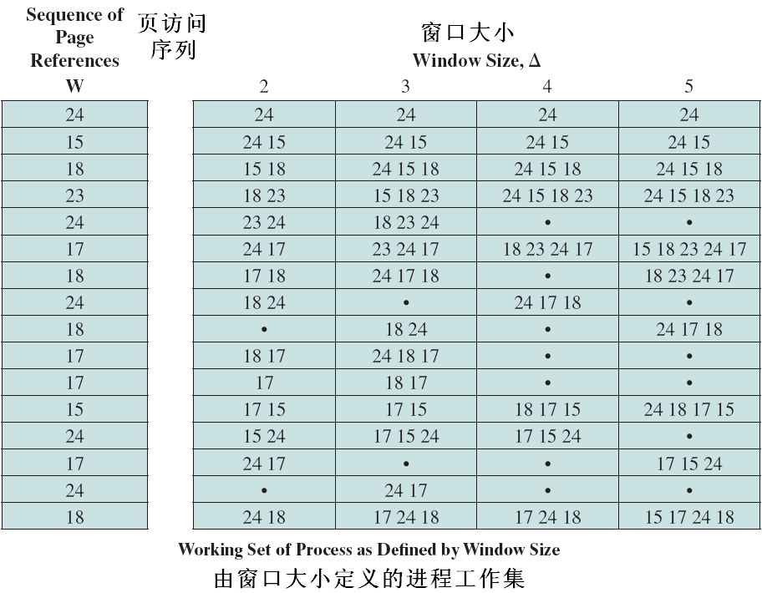
工作集
示例

Slide 106
工作集大小的变化
进程开始执行时，随着访问新页面逐步增大
当内存访问的局部性区域的位置大致稳定时，工作集大小也大致稳定
局部性区域的位置改变时，工作集快速扩张和收缩过渡到下一个稳定值

Slide 107
工作集的性质
随Δ单调递增：
W(t, Δ) ⊆ W(t,Δ+ a)，其中 a>0
工作集大小范围：
1≤|W(t,Δ)|≤min(Δ,N)，
其中 N 是进程的总页面数

Slide 108
工作集策略
利用工作集来进行驻留集调整的策略：
记录一个进程的工作集变化
定期删除驻留集中不在工作集中的页面
总是让驻留集包含工作集（不能包含时则增大驻留集）
存在问题：
工作集的过去变化未必能够预示工作集的将来（大小或组成页面均可能会改变）
记录每个进程的工作集变化所要求的开销太大
对工作集窗口大小Δ的最优值难以确定，而且通常该值是不断变化的

Slide 109
工作集策略的接近策略
缺页率 (PFF，Page Fault Frequency) 算法：跟踪缺页率而不是工作集的变化！
设定缺页率高/低阈值，缺页率高/低于相应阈值时，增加/减少驻留集大小
主要缺点：在局部性阶段的过渡期间效果不好
VSWS (Variable-interval Sampled Working Set，可变间隔采样工作集)策略
通过增加采样频率来解决PFF算法的缺点
驱动参数：采样区间的最大/最小宽度M/L（为异常条件提供边界保护）、采样实例间允许发生的缺页中断数Q（使能正常激活采样）
策略：
采样间隔达到L时挂起进程并扫描使用位
若在采样间隔<L时发生了Q次缺页中断
采样间隔<M，则一直等待
采样间隔≥M，则扫描使用位

Slide 110
Does adding RAM always reduce misses?
Yes for LRU and MIN
Memory content of X pages ⊆ X + 1 pages
No for FIFO
Due to modulo math
Belady’s anomaly: getting more page faults by increasing the memory size

Slide 111
Belady’s Anomaly
9 page faults
Memory page | A | B | C | D | A | B | E | A | B | C | D | E
1 | A |  |  | D |  |  | E |  |  |  |  | *
2 |  | B |  |  | A |  |  | * |  | C
3 |  |  | C |  |  | B |  |  | * |  | D

Slide 112
Belady’s Anomaly
10 page faults
Memory page | A | B | C | D | A | B | E | A | B | C | D | E
1 | A |  |  |  | * |  | E |  |  |  | D
2 |  | B |  |  |  | * |  | A |  |  |  | E
3 |  |  | C |  |  |  |  |  | B
4 |  |  |  | D |  |  |  |  |  | C

Slide 113
Possibility of Thrashing
If a process does not have “enough” pages, the page-fault rate is very high. This leads to:
low CPU utilization.
operating system thinks that it needs to increase the degree of multiprogramming.
another process added to the system.
This just increases the load on physical memory.
Thrashing = a process is busy swapping pages in and out.
PPTs from others\From Ariel J. Frank\OS381\os8-2_vir.ppt

Slide 114
You can try those algorithms by yourself
Assume:
3 frames
Reference string: 7,0,1,2,0,3,0,4,2,3,0,3,2,1,2,0,1,7,0,1
Each of the numbers refers to a page number
Your task now
FIFO
LRU
Clock

Slide 115
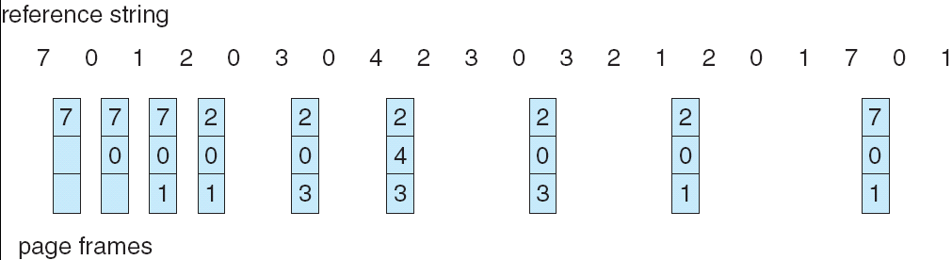
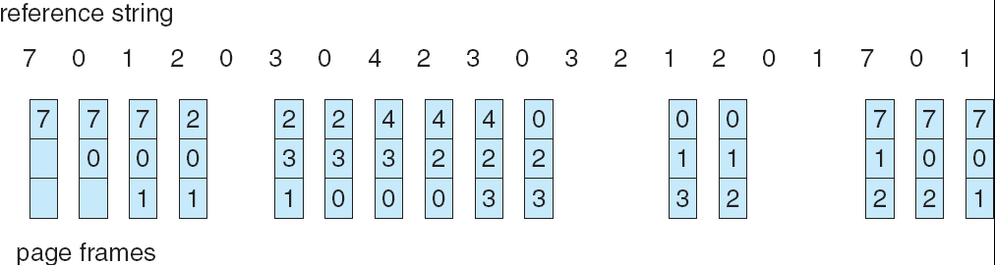
Optimal
FIFO
Note: The read arrow is pointing to the oldest page

Slide 116
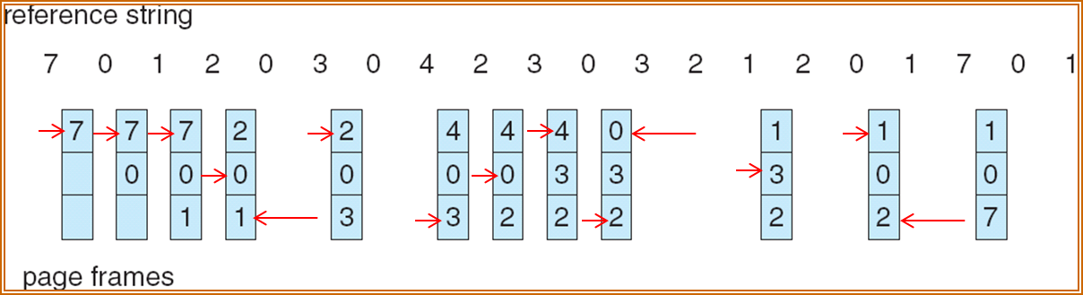
LRU

Slide 117
Virtual Memory
Paging
Basic paging
Paging-based VM
How to support the transparency of using space larger than the physical memory space
Page replacement algorithms
Segmenting
Basic segmenting
Segmentation-based VM
How to support the transparency of using space larger than the physical memory space
Segment-page scheme

Slide 118
Motivation of Segmenting
Paging
Mapping to allow differentiation between logical memory and physical memory.
Separation of the user’s view of memory and the actual physical memory.
Chopping a process into equally-sized pieces.
→Paging division is arbitrary; no natural/logical boundaries for protection/sharing.
➔ Any scheme for dividing a process into a collection of semantic units?
(syntactic [语法的], semantic [语义的])
PPTs from others\OS PPT in English\ch09.ppt

Slide 119
Segmentation(分段)
Segmentation could be seen as the extension of variable partitioning
Each program is subdivided into blocks of non-equal size called segments.
Cut your program according to semantic organization, such as following function, or class etc.
Allocate MM region whose size is just the size of the needed segment
When a process gets loaded into main memory, its different segments can be located anywhere.
PPTs from others\SCU_Zhaohui\OS\Chapter07.ppt

Slide 120
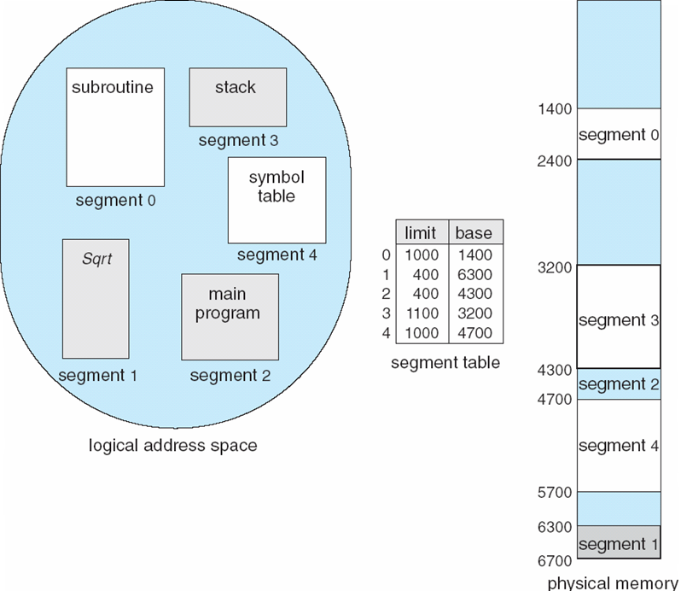
Example of Segmentation
Addressing consist of two parts - a segment number(段号) and an offset(偏移量)
PPTs from others\From Ariel J. Frank\OS381\os7-4_rea.ppt

Slide 121
Dynamics of Simple Segmentation
There is external fragmentation; it is reduced when using small segments.
Each segment is fully packed with instructions/data; no internal fragmentation.
In contrast with paging, segmentation is visible to the programmer:
provided as a convenience to organize logically programs (example: data in one segment, code in another segment).
must be aware of segment size limit.
The OS maintains a segment table for each process. Each entry contains:
the starting physical addresses of that segment.
the length of that segment (for protection).
PPTs from others\From Ariel J. Frank\OS381\os7-4_rea.ppt

Slide 122
Virtual Memory
Paging
Basic paging
Paging-based VM
How to support the transparency of using space larger than the physical memory space
Segmenting
Basic segmenting
Segmentation-based VM
How to support the transparency of using space larger than the physical memory space
Segment-page scheme

Slide 123
Logical address used in segmentation
Logical address now is divided into two parts:
(segment number, offset) = (s, d), the CPU indexes (with s) the segment table to obtain the starting physical address b and the length l of that segment.
The physical address is obtained by adding d to b (in contrast with paging):
The hardware also compares the offset d with the length l of that segment to determine if the address is valid.
Notes:
[2012-10-20]
“The physical address is obtained by adding d to b (in contrast with paging):” means that the starting address of a page could be computed directly!
If the size of MM is 2⁵(0 ~ 2⁵-1) , and page size is 2³, there are 4 pages. The starting address of page 0 must be 0. The address of page 1 must be 2³. And the starting address of page 2 must be 2⁴ = 2³ + 2³.

Slide 124
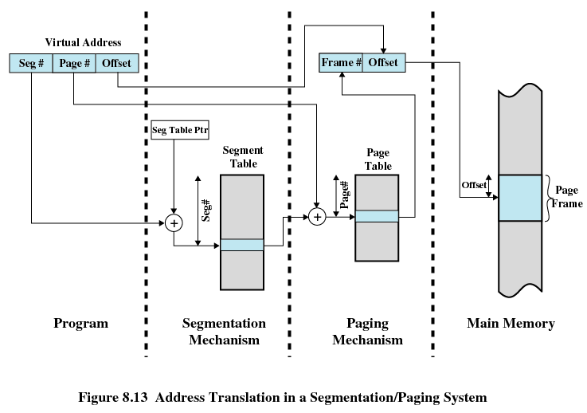
Address Translation in hybrid method
PPTs from others\OS5e after William Stallings\Chapter08.ppt
PPTs from others\From Ariel J. Frank\OS381\os8-2_vir.ppt

Slide 125
Sharing in Segmentation Systems
Segments are shared when entries in the segment tables of 2 different processes point to the same physical locations.
Example: the same code of a text editor can be shared by many users:
Only one copy is kept in main memory.
But each user would still need to have its own private data segment.
PPTs from others\From Ariel J. Frank\OS381\os7-4_rea.ppt

Slide 126
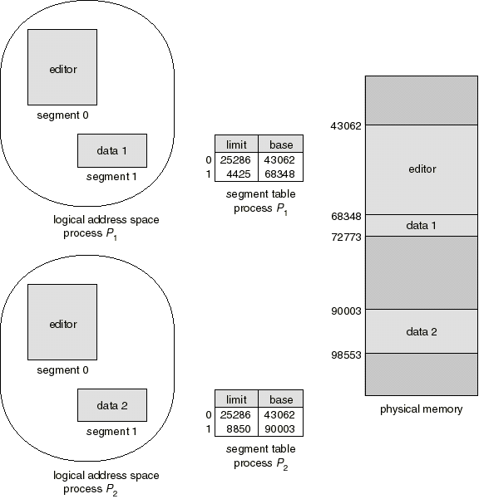
Shared Segments Example
PPTs from others\From Ariel J. Frank\OS381\os7-4_rea.ppt

Slide 127
Virtual Memory
Paging
Basic paging
Supporting VM
Segmenting
Basic segmenting
Supporting VM
Segment-page scheme

Slide 128
Segmentation + Paging
Paging or segmentation?
In the old days,
Motorola 68000 used paging.
Intel 80x86 used segmentation.
Now
both combines paging and segmentation
The OS for I386
OS/2 from IBM
NT from MS
PPTs from others\OS PPT in English\ch09.ppt

Slide 129
virtual address from user
descriptor
offset
limit
base
+
segment table
linear address
directory
page
offset
page frame
PT directory (PageTable)
page table
directory base

Slide 130
Segmentation + Paging: MULTICS
The MULTICS system solved problems of external fragmentation and lengthy search times by paging the segments.
Solution differs from pure segmentation in that the segment-table entry contains not the base address of the segment, but rather the base address of a page table for this segment.
Example in the next slide.
PPTs from others\From Ariel J. Frank\OS381\os7-4_rea.ppt

Slide 131
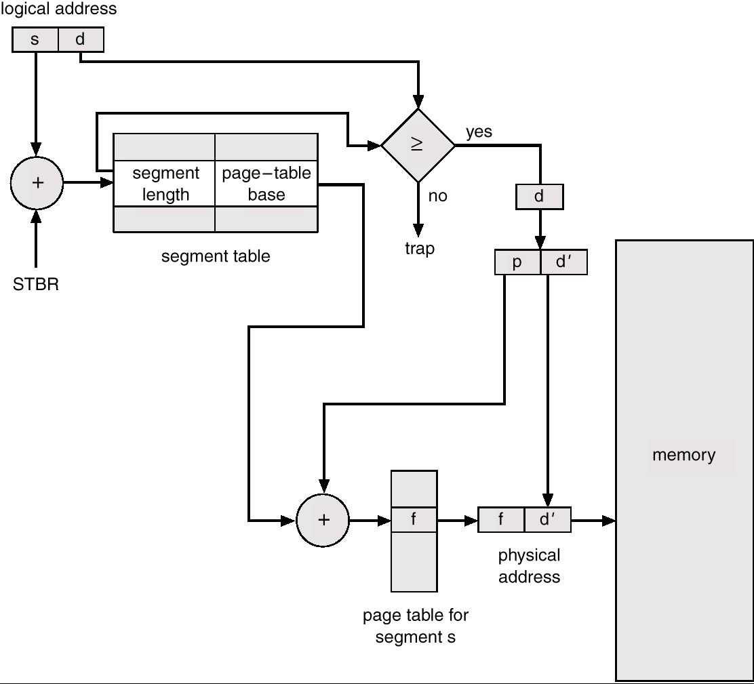
MULTICS Address Translation Scheme
PPTs from others\From Ariel J. Frank\OS381\os7-4_rea.ppt

Slide 132
Dealing with Large Page Tables

Slide 133
Structure of the Page Table
Typically systems have large logical address spaces
Page table could be excessively large
Example:
32-bit logical address space
The number of possible addresses in the logical address space is 2³²
Page size is 4 KB (4096 bytes or 2¹²)
Number of pages is 2²⁰ (20 bits for page number)
Page table may consist of up to 1 million entries

Slide 134
Structure of Page Table
Several approaches
Multi-Level Page tables
Hashed Page Tables
Inverted Page Tables

Slide 135
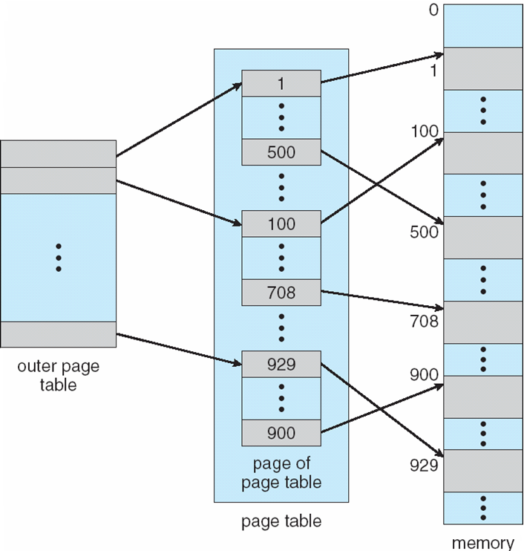
Two-Level Page-Table Scheme
Page table is also paged
Need to be able to index
the outer page table
Notes:
Outer page table – each entry represents a set of pages….
P1

Slide 136
Two-Level Paging Example
A logical address (on 32-bit machine with 1K page size) is divided into:
A page number consisting of 22 bits
A page offset consisting of 10 bits
Since the page table is paged, the page number is further divided into:
A 12-bit page number
A 10-bit page offset

Slide 137
Two-Level Paging Example
Thus, a logical address is as follows: where p₁ is an index into the outer page table, and p₂ is the displacement within the page of the outer page table
page number
page offset
p₁
p₂
d
12
10
10

Slide 138
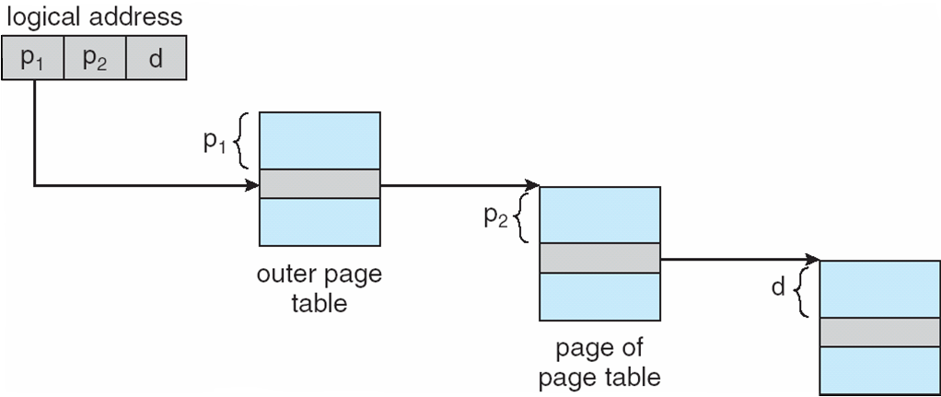
Address-Translation Scheme
p₁ is used to index the outer page table
p₂ is used to index the page table

Slide 139
Multi-level Paging
What if you have a 64-bit architecture?
Do you think hierarchical paging is a good idea?
How many levels of paging are needed?
What is the relationship between paging and memory accesses?
64-bit means that even the outer page is large
The 64-bit UltraSPARC requires 7 levels of paging

Slide 140
Hashed Page Tables
Common in address spaces larger than 32 bits
The page number is hashed into a page table
This page table contains a chain of elements hashing to the same location
Virtual page numbers are compared in this chain searching for a match
If a match is found, the corresponding physical frame is extracted

Slide 141
Case studies

Slide 142
Case Study – Windows
Virtual memory with demand page
Can support 32 or 64 bit
Has a pool of free frames
Uses prepaging (called clustering)
What happens if the amount of free memory falls below some threshold?
Each process has a minimum number of processes
Windows will take away pages that exceed that minimum
Applies LRU Locally

Slide 143
Case Study - Window
Each process is guaranteed to have a minimum number of frames
Each process has a maximum number of frames
If a page fault occurs for a process that has the maximum number of frames a local replacement policy is used
If a page fault occurs for a process that is below its working set maximum a free frame is used.

Slide 144
Case Study - Linux
Virtual memory with demand paging
Can support 32 or 64 bit
Replacement
Least recently used (LRU) policy
Different implementations for different systems

Slide 145
Case Study-Android, IoS
PCs and Servers: Support some form of swapping
Mobile devices -- Rely a lot on flash memory for persistent storage
It’s fast
Flash memory can tolerate a limited number of writes before it becomes unreliable
Support
Typically no swapping
Paged systems

Slide 146
Case Study-Android
No swap space for memory
Does have
Paging
Map pages to physical pages
Implications
Modified data (e.g., stack is not removed)
Read-only data (e.g., code) can be removed from the system and reloaded from flash memory

Slide 147
Case Study -- Android
zygote [ˈzaiɡəut]n.合子, 受精卵
Sharing Memory
Each app is forked from an existing process called Zygote
Zygote loads framework code
RAM pages allocated for framework code is shared by application processes
Static data (e.g., code) is often mapped to specific pages
Some dynamic memory is explicitly shared by Android and applications
Example: Window surfaces use shared memory between the app and screen compositor

Slide 148
Case Study - Android
Switching applications
Android keeps processes that are not hosting a foreground ("user visible") app component in a least-recently used (LRU) cache.
The system keeps the process cached, so if the user later returns to the app, the process is reused for faster app switching.
As the system runs low on memory, it may kill processes in the LRU cache beginning with the process least recently used

Slide 149
Case Study-Android
Implications
Developers must carefully allocate and release memory to ensure that their applications do not use too much memory or suffer from memory leaks

